Slide 1
Unit -1
Java Servlets

Slide 2
Introduction to Servlets
Java Servlets are the Java programs that run on the Java-enabled web server or application server.
They are used to handle the request obtained from the web server, process the request, produce the response, and then send a response back to the web server.
Servlets are written in Java and are platform independent.

Slide 3
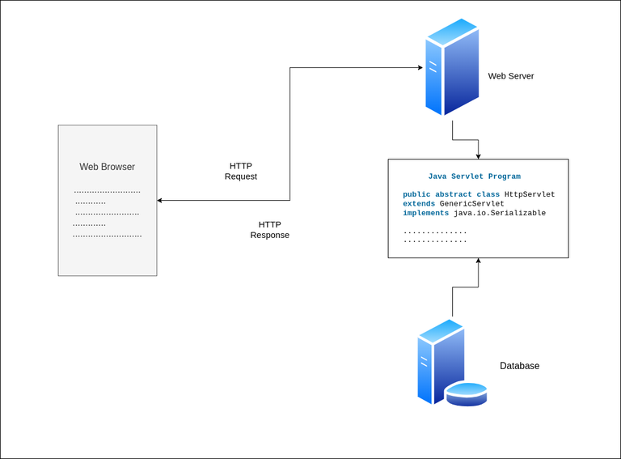
Java Servlets Architecture

Slide 4
Execution of Java Servlets
Execution of Servlets basically involves Six basic steps:
The Clients send the request to the Web Server.
The Web Server receives the request.
The Web Server passes the request to the corresponding servlet.
The Servlet processes the request and generates the response in the form of output.
The Servlet sends the response back to the webserver.
The Web Server sends the response back to the client and the client browser displays it on the screen.
Execution of Servlets basically involves Six basic steps:

Slide 5
CGI(Common Gateway Interface)
CGI is actually an external application that is written by using any of the programming languages like C or C++ and this is responsible for processing client requests and generating dynamic content.
In CGI application, when a client makes a request to access dynamic Web pages, the Web server performs the following operations:
It first locates the requested web page i.e the required CGI application using URL.
It then creates a new process to service the client’s request.
Invokes the CGI application within the process and passes the request information to the application.
Collects the response from the CGI application.
Destroys the process, prepares the HTTP response, and sends it to the client.
Execution of Servlets basically involves Six basic steps:

Slide 6
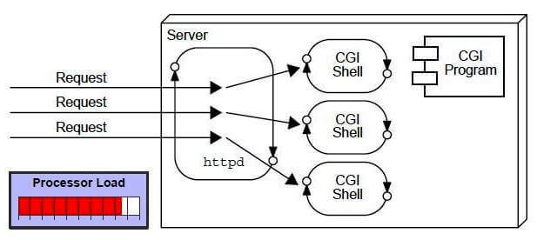
CGI(Common Gateway Interface)
Execution of Servlets basically involves Six basic steps:

Slide 7
Disadvantages of CGI
There are many problems in CGI technology:
If the number of clients increases, it takes more time for sending the response.
For each request, it starts a process, and the web server is limited to start processes.
It uses platform dependent language e.g. C,C++,Perl.
Execution of Servlets basically involves Six basic steps:

Slide 8
Advantages of Servlet
The advantages of Servlet are as follows:
Better performance: because it creates a thread for each request, not process.
Robust: JVM manages Servlets, so we don't need to worry about the memory leak, GarbageCollection, etc.
Secure & platform independent : because it uses java language.
Execution of Servlets basically involves Six basic steps:

Slide 9
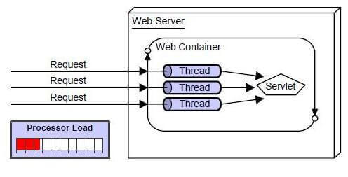
Advantages of Servlet
Execution of Servlets basically involves Six basic steps:

Slide 10
Server
Server is a device or a computer program that accepts and responds to the request made by other program, known as client.
It is used to manage the network resources and for running the program or software that provides services.
Execution of Servlets basically involves Six basic steps:

Slide 11
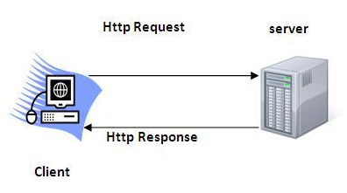
HTTP
HTTP is TCP/IP based communication protocol, which is used to deliver the data like image files, query results, HTML files etc on the World Wide Web with the default port is TCP 80.
It is the data communication protocol used to establish communication between client and server.
Execution of Servlets basically involves Six basic steps:

Slide 12
HTTP Request
The request sent by the computer to a web server, contains all sorts of potentially interesting information; it is known as HTTP requests.
The HTTP request method indicates the method to be performed on the resource identified by the Requested URI (Uniform Resource Identifier). This method is case-sensitive and should be used in uppercase.
The HTTP request methods are:
GET:- Asks to get the resource at the requested URL.
Execution of Servlets basically involves Six basic steps:

Slide 13
HTTP Request
POST:-Asks the server to accept the body info attached. It is like GET request with extra info sent with the request.
PUT:- Says to put the enclosed info (the body) at the requested URL.
DELETE:- Says to delete the resource at the requested URL.
Execution of Servlets basically involves Six basic steps:

Slide 14
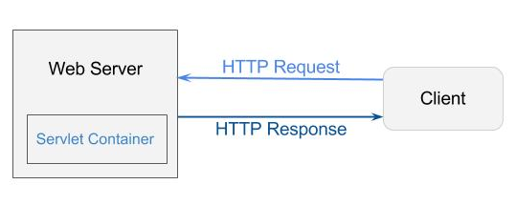
Servlet Container
It provides the runtime environment for JavaEE (j2ee) applications.
It manages the lifecycle of a Servlet.
It handles authorization and authentication of resource access.
It provides the service of decoding and encoding MIME-based messages.
Execution of Servlets basically involves Six basic steps:

Slide 15
Servlet Life Cycle
The web container maintains the life cycle of a servlet instance. Let's see the life cycle of the servlet:
Servlet class is loaded
The classloader is responsible to load the servlet class. The servlet class is loaded when the first request for the servlet is received by the web container.
2. Servlet instance is created
The web container creates the instance of a servlet after loading the servlet class. The servlet instance is created only once in the servlet life cycle.
Execution of Servlets basically involves Six basic steps:

Slide 16
Servlet Life Cycle
3. init method is invoked
The web container calls the init method only once after creating the servlet instance. The init method is used to initialize the servlet. It is the life cycle method of the javax.servlet.Servlet interface. Syntax of the init method is given below:
public void init(ServletConfig config) throws ServletException
Execution of Servlets basically involves Six basic steps:

Slide 17
Servlet Life Cycle
4. service method is invoked
The web container calls the service method each time when request for the servlet is received. If servlet is not initialized, it follows the first three steps as described above then calls the service method. If servlet is initialized, it calls the service method. Notice that servlet is initialized only once. The syntax of the service method of the Servlet interface is given below:
public void service(ServletRequest request, ServletResponse response)
throws ServletException, IOException
Execution of Servlets basically involves Six basic steps:

Slide 18
Servlet Life Cycle
5. destroy method is invoked
The web container calls the destroy method before removing the servlet instance from the service. It gives the servlet an opportunity to clean up any resource for example memory, thread etc. The syntax of the destroy method of the Servlet interface is given below:
public void destroy()
Execution of Servlets basically involves Six basic steps:

Slide 19
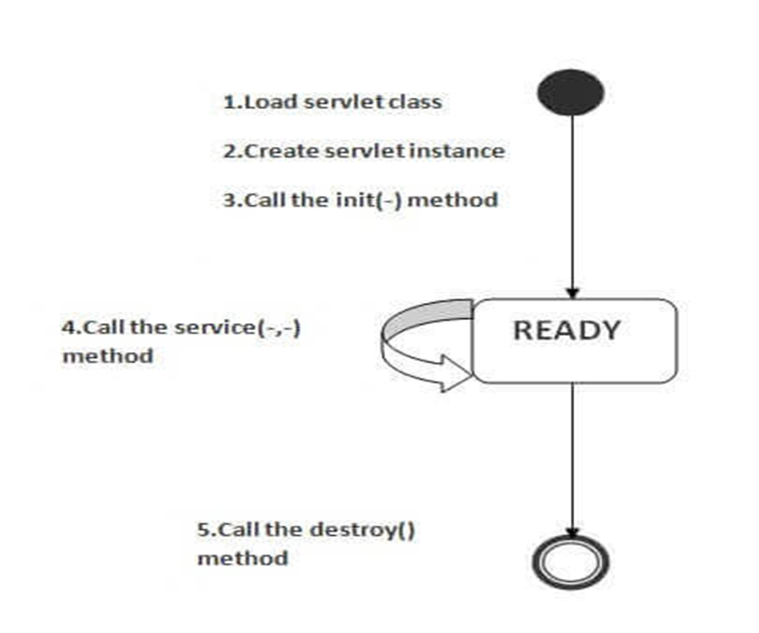
Servlet Life Cycle
Execution of Servlets basically involves Six basic steps:

Slide 20
Servlet API
The javax.servlet and javax.servlet.http packages represent interfaces and classes for servlet api.(after tomcat 10 and later jakarta.servlet and jakarta.servlet.http).
The jakarta.servlet package contains many interfaces and classes that are used by the servlet or web container. These are not specific to any protocol.
The jakarta.servlet.http package contains interfaces and classes that are responsible for http requests only.

Slide 21
Servlet Interface
Servlet interface provides common behavior to all the servlets.Servlet interface defines methods that all servlets must implement.
Servlet interface needs to be implemented for creating any servlet (either directly or indirectly).
It provides 3 life cycle methods that are used to initialize the servlet, to service the requests, and to destroy the servlet and 2 non-life cycle methods.

Slide 22
Methods of Servlet Interface
Method | Description
public void init(ServletConfig config) | initializes the servlet. It is the life cycle method of servlet and invoked by the web container only once.
public void service(ServletRequest request,ServletResponse response) | provides response for the incoming request. It is invoked at each request by the web container.
public void destroy() | is invoked only once and indicates that servlet is being destroyed.
public ServletConfig getServletConfig() | returns the object of ServletConfig.
public String getServletInfo() | returns information about servlet such as writer, copyright, version etc.

Slide 23
Example of Servlet Interface
import jarkarta.servlet.*;
public class First implements Servlet{
ServletConfig config=null;
public void init(ServletConfig config){
this.config=config;
System.out.println("servlet is initialized"); }
public void service(ServletRequest req,ServletResponse res)
throws IOException,ServletException{
res.setContentType("text/html"); }
public void destroy(){System.out.println("servlet is destroyed");}
public ServletConfig getServletConfig(){return config;}
public String getServletInfo(){return "copyright 2007-1010";}

Slide 24
GenericServlet class
GenericServlet class implements Servlet, ServletConfig and Serializable interfaces.
It provides the implementation of all the methods of these interfaces except the service method.
GenericServlet class can handle any type of request so it is protocol-independent.
You may create a generic servlet by inheriting the GenericServlet class and providing the implementation of the service method.

Slide 25
Example of GenericServlet class
import java.io.*;
import jakarta.servlet.*;
public class First extends GenericServlet{
public void service(ServletRequest req,ServletResponse res)
throws IOException,ServletException{
res.setContentType("text/html");
PrintWriter out=res.getWriter();
out.print("<html><body>");
out.print("<b>hello generic servlet</b>");
out.print("</body></html>"); } }

Slide 26
HttpServlet class
The HttpServlet class extends the GenericServlet class and implements Serializable interface.
HTTP Servlets are designed to seamlessly work within the HTTP protocol framework, enabling robust and efficient web applications.
Key Methods in HTTP Servlet
doGet(HttpServletRequest req, HttpServletResponse res): Handles GET requests.
doPost(HttpServletRequest req, HttpServletResponse res): Handles POST requests.
doPut, doDelete: Handle respective HTTP methods.

Slide 27
Example of HttpServlet class
import java.io.*;
import jakarta.servlet.*;
@WebServlet("/example")
public class ExampleServlet extends HttpServlet {
protected void doGet(HttpServletRequest request, HttpServletResponse response) throws IOException { response.getWriter().println("Hello, Servlet!");
}
}

Slide 28
ServletConfig Interface
An object of ServletConfig is created by the web container for each servlet. This object can be used to get configuration information from web.xml file.
The core advantage of ServletConfig is that you don't need to edit the servlet file if information is modified from the web.xml file.
Syntax:-
public ServletConfig getServletConfig();

Slide 29
ServletContext Interface
An object of ServletContext is created by the web container at time of deploying the project. This object can be used to get configuration information from web.xml file. There is only one ServletContext object per web application.
It is easy to maintain if any information is shared to all the servlet, it is better to make it available for all the servlet. We provide this information from the web.xml file, so if the information is changed, we don't need to modify the servlet.
getServletContext() method of ServletConfig interface returns the object of ServletContext.

Slide 30
RequestDispatcher Interface
The RequestDispatcher interface provides the facility of dispatching the request to another resource it may be html, servlet or jsp.
This interface can also be used to include the content of another resource also. It is one of the way of servlet collaboration.
There are two methods defined in the RequestDispatcher interface.
public void forward(ServletRequest request,ServletResponse response)throws ServletException,java.io.IOException:Forwards a request from a servlet to another resource (servlet, JSP file, or HTML file) on the server.
public void include(ServletRequest request,ServletResponse response)throws ServletException,java.io.IOException:Includes the content of a resource (servlet, JSP page, or HTML file) in the response.

Slide 31
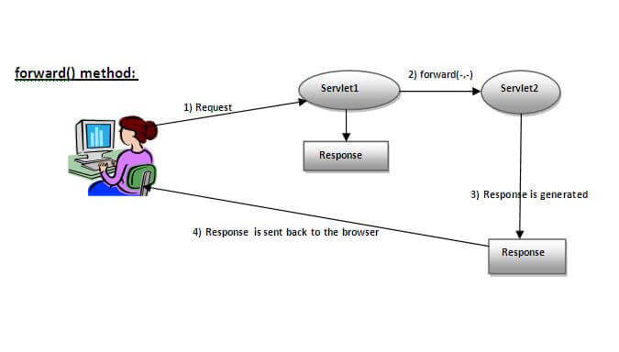
RequestDispatcher Interface

Slide 32
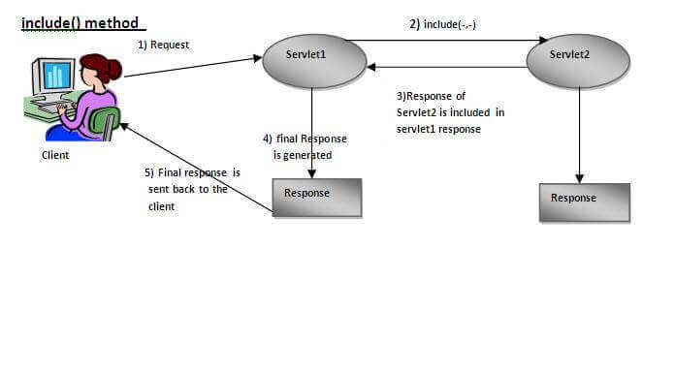
RequestDispatcher Interface

Slide 33
sendRedirect
The sendRedirect() method of HttpServletResponse interface can be used to redirect response to another resource, it may be servlet, jsp or html file.
It accepts relative as well as absolute URL.
It works at client side because it uses the url bar of the browser to make another request. So, it can work inside and outside the server.

Slide 34
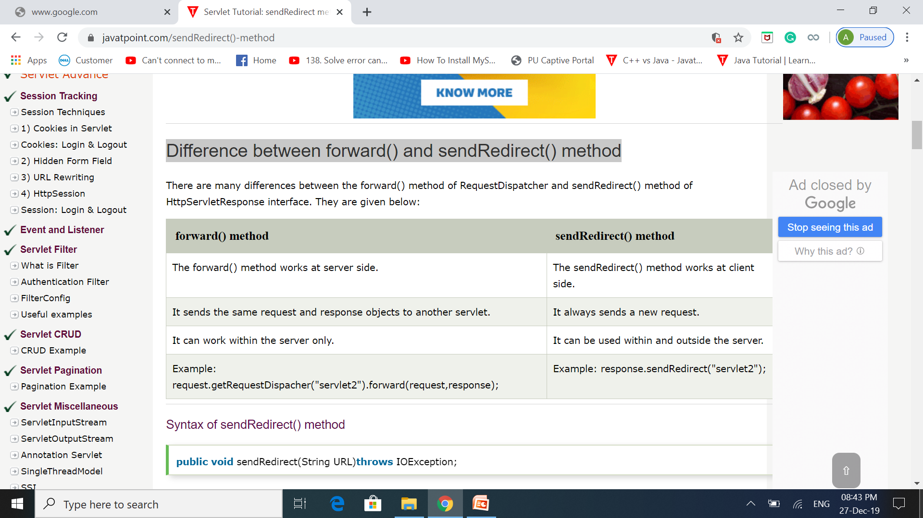
sendRedirect() VS forward()

Slide 35
Session Tracking in Servlets
Session simply means a particular interval of time.
Session Tracking is a way to maintain state (data) of an user. It is also known as session management in servlet.
Http protocol is a stateless so we need to maintain state using session tracking techniques. Each time user requests to the server, server treats the request as the new request. So we need to maintain the state of an user to recognize to particular user.
There are four techniques used in Session tracking:
Cookies
Hidden Form Field
URL Rewriting
HttpSession

Slide 36
Cookies
A cookie is a small piece of information that is persisted between the multiple client requests.
A cookie has a name, a single value, and optional attributes such as a comment, path and domain qualifiers, a maximum age, and a version number.
By default, each request is considered as a new request. In cookies technique, we add cookie with response from the servlet. So cookie is stored in the cache of the browser. After that if request is sent by the user, cookie is added with request by default. Thus, we recognize the user as the old user.

Slide 37
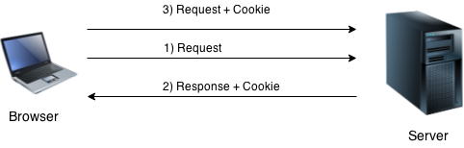
Cookies
There are 2 types of cookies in servlets.
Non-persistent cookie:- It is valid for single session only. It is removed each time when user closes the browser.
Persistent cookie:It is valid for multiple session . It is not removed each time when user closes the browser. It is removed only if user logout or signout.

Slide 38
Cookies
Advantage of Cookies
Simplest technique of maintaining the state.
Cookies are maintained at client side.
Disadvantage of Cookies
It will not work if cookie is disabled from the browser.
Only textual information can be set in Cookie object.

Slide 39
Cookie Class
jakarta.servlet.http.Cookie class provides the functionality of using cookies. It provides a lot of useful methods for cookies.
For adding cookie or getting the value from the cookie, we need some methods provided by other interfaces. They are:
public void addCookie(Cookie ck):method of HttpServletResponse interface is used to add cookie in response object.
public Cookie[] getCookies():method of HttpServletRequest interface is used to return all the cookies from the browser.

Slide 40
Cookie Class
Constructor | Description
Cookie() | constructs a cookie.
Cookie(String name, String value) | constructs a cookie with a specified name and value.
Method | Description
public void setMaxAge(int expiry) | Sets the maximum age of the cookie in seconds.
public String getName() | Returns the name of the cookie. The name cannot be changed after creation.
public String getValue() | Returns the value of the cookie.
public void setName(String name) | changes the name of the cookie.
public void setValue(String value) | changes the value of the cookie.

Slide 41
Hidden Form Field
In case of Hidden Form Field a hidden (invisible) textfield is used for maintaining the state of an user.
In such case, we store the information in the hidden field and get it from another servlet. This approach is better if we have to submit form in all the pages and we don't want to depend on the browser.
Example:
<input type="hidden" name="uname" value="Vimal Jaiswal">

Slide 42
Hidden Form Field
Advantage of Hidden Form Field:
It will always work whether cookie is disabled or not.
Disadvantage of Hidden Form Field:
It is maintained at server side.
Extra form submission is required on each pages.
Only textual information can be used.

Slide 43
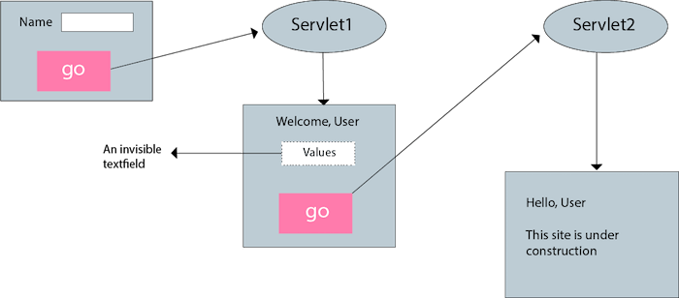
Hidden Form Field

Slide 44
URL Rewriting
In URL rewriting, we append a token or identifier to the URL of the next Servlet or the next resource. We can send parameter name/value pairs using the following format:
url?name1=value1&name2=value2&??
A name and a value is separated using an equal = sign, a parameter name/value pair is separated from another parameter using the ampersand(&). When the user clicks the hyperlink, the parameter name/value pairs will be passed to the server. From a Servlet, we can use getParameter() method to obtain a parameter value.

Slide 45
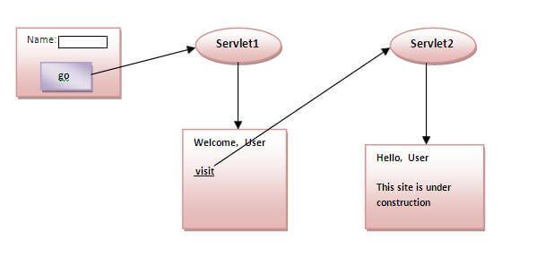
URL Rewriting

Slide 46
URL Rewriting
Advantage of URL Rewriting
It will always work whether cookie is disabled or not (browser independent).
Extra form submission is not required on each pages.
Disadvantage of URL Rewriting
It will work only with links.
It can send Only textual information.

Slide 47
Http Session Interface
In Http Session , container creates a session id for each user. The container uses this id to identify the particular user.
An object of HttpSession can be used to perform two tasks:
bind objects
view and manipulate information about a session, such as the session identifier, creation time, and last accessed time.

Slide 48
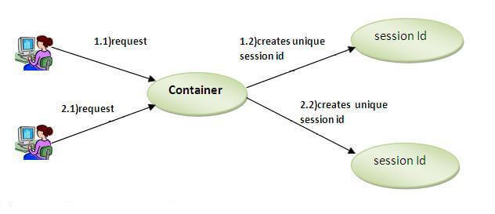
Http Session Interface

Slide 49
Http Session Interface
The HttpServletRequest interface provides two methods to get the object of HttpSession:
public HttpSession getSession():Returns the current session associated with this request, or if the request does not have a session, creates one.
public HttpSession getSession(boolean create):Returns the current HttpSession associated with this request or, if there is no current session and create is true, returns a new session.
public String getId():Returns a string containing the unique identifier value.
public long getCreationTime():Returns the time when this session was created, measured in milliseconds since midnight January 1, 1970.

Slide 50
Servlet Filter
A filter is an object that is invoked at the preprocessing and postprocessing of a request.
It is mainly used to perform filtering tasks such as conversion, logging, compression, encryption and decryption, input validation etc.
The servlet filter is pluggable, i.e. its entry is defined in the web.xml file, if we remove the entry of filter from the web.xml file, filter will be removed automatically and we don't need to change the servlet.

Slide 51
Servlet Filter
Usage of Filter
recording all incoming requests
logs the IP addresses of the computers from which the requests originate
conversion
data compression
encryption and decryption
input validation etc.
Advantage of Filter
Filter is pluggable.
One filter don't have dependency onto another resource.
Less Maintenance

Slide 52
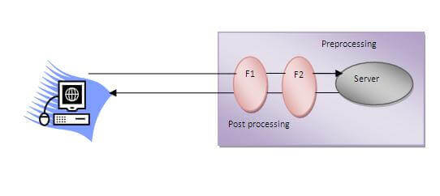
Servlet Filter

Slide 53
Filter API
Like servlet filter have its own API. The javax.servlet package contains the three interfaces of Filter API.
1) Filter interface
For creating any filter, you must implement the Filter interface. Filter interface provides the life cycle methods for a filter.
Method | Description
public void init(FilterConfig config) | init() method is invoked only once. It is used to initialize the filter.
public void doFilter(HttpServletRequest request,HttpServletResponse response, FilterChain chain) | doFilter() method is invoked every time when user request to any resource, to which the filter is mapped.It is used to perform filtering tasks.
public void destroy() | This is invoked only once when filter is taken out of the service.

Slide 54
Filter API
2) FilterChain interface
The object of FilterChain is responsible to invoke the next filter or resource in the chain.
This object is passed in the doFilter method of Filter interface.
The FilterChain interface contains only one method:
public void doFilter(HttpServletRequest request, HttpServletResponse response): it passes the control to the next filter or resource.

Slide 55
Filter API
3) FilterConfig
An object of FilterConfig is created by the web container. This object can be used to get the configuration information from the web.xml file.
Methods of FilterConfig interface
There are following 3 methods in the FilterConfig interface.
public void init(FilterConfig config): init() method is invoked only once it is used to initialize the filter.
public String getInitParameter(String parameterName): Returns the parameter value for the specified parameter name.
public ServletContext getServletContext(): Returns the ServletContext object.

Slide 56
Creating Custom filter
Steps:
Implement Filter interface.
Override methods: init(), doFilter(), and destroy().
Register the filter in web.xml or use annotations.
Example Code:
public class MyFilter implements Filter {
public void init(FilterConfig config) throws ServletException {
// Initialization code
}
public void doFilter(ServletRequest request, ServletResponse response, FilterChain chain)
throws IOException, ServletException {

Slide 57
Creating Custom filter
// Pre-processing
chain.doFilter(request, response); // Forward to the next filter or servlet
// Post-processing
}
public void destroy() {
// Cleanup code
}
}

Slide 58
Mapping Filters to Servlets
We can map Filters using two ways:
1. Declarative Mapping (web.xml):
<filter>
<filter-name>MyFilter</filter-name>
<filter-class>com.example.MyFilter</filter-class>
</filter>
<filter-mapping>
<filter-name>MyFilter</filter-name>
<servlet-name>MyServlet</servlet-name>
</filter-mapping>

Slide 59
Mapping Filters to Servlets
2. Annotation-Based Mapping:
@WebFilter(servletNames = {"MyServlet"})
public class MyFilter implements Filter {
// Implementation
}

Slide 60
Mapping Filters to Specific URL Patterns
1. Declarative Mapping (web.xml):
<filter-mapping>
<filter-name>MyFilter</filter-name>
<url-pattern>/secure/*</url-pattern>
</filter-mapping>
2. Annotation-Based Mapping:
@WebFilter(urlPatterns = {"/secure/*"})
public class MyFilter implements Filter {
// Implementation
}

